Slide 1


Identifying Alcohol Use Disorder Phenotypes Using Regular Expressions
Michaela Robinson
Dr. Alvin Jeffery
BEST DS-2 Intern, Fisk University
Department of Biomedical Informatics, Vanderbilt University Medical Center

Slide 2
Alcohol use disorder is common, costly, & problematic
Around 28.8 million adults ages 18 and older were reported with Alcohol Use Disorder (AUD) in 2021. Additionally, 753,000 youth (12-17 years) were diagnosed with AUD (NIH, 2020).
It can cause disruption to daily life, relationships, and health. The average cost of alcohol use in the US averages around $2,000 a year and more.
Unfortunately, it may go undetected by clinicians who may not recognise the signs of AUD; stigma
https://www.apa.org/topics/substance-use-abuse-addiction/alcohol-disorders
https://landmarkrecovery.com/the-cost-of-alcohol-use-disorder/

Slide 3

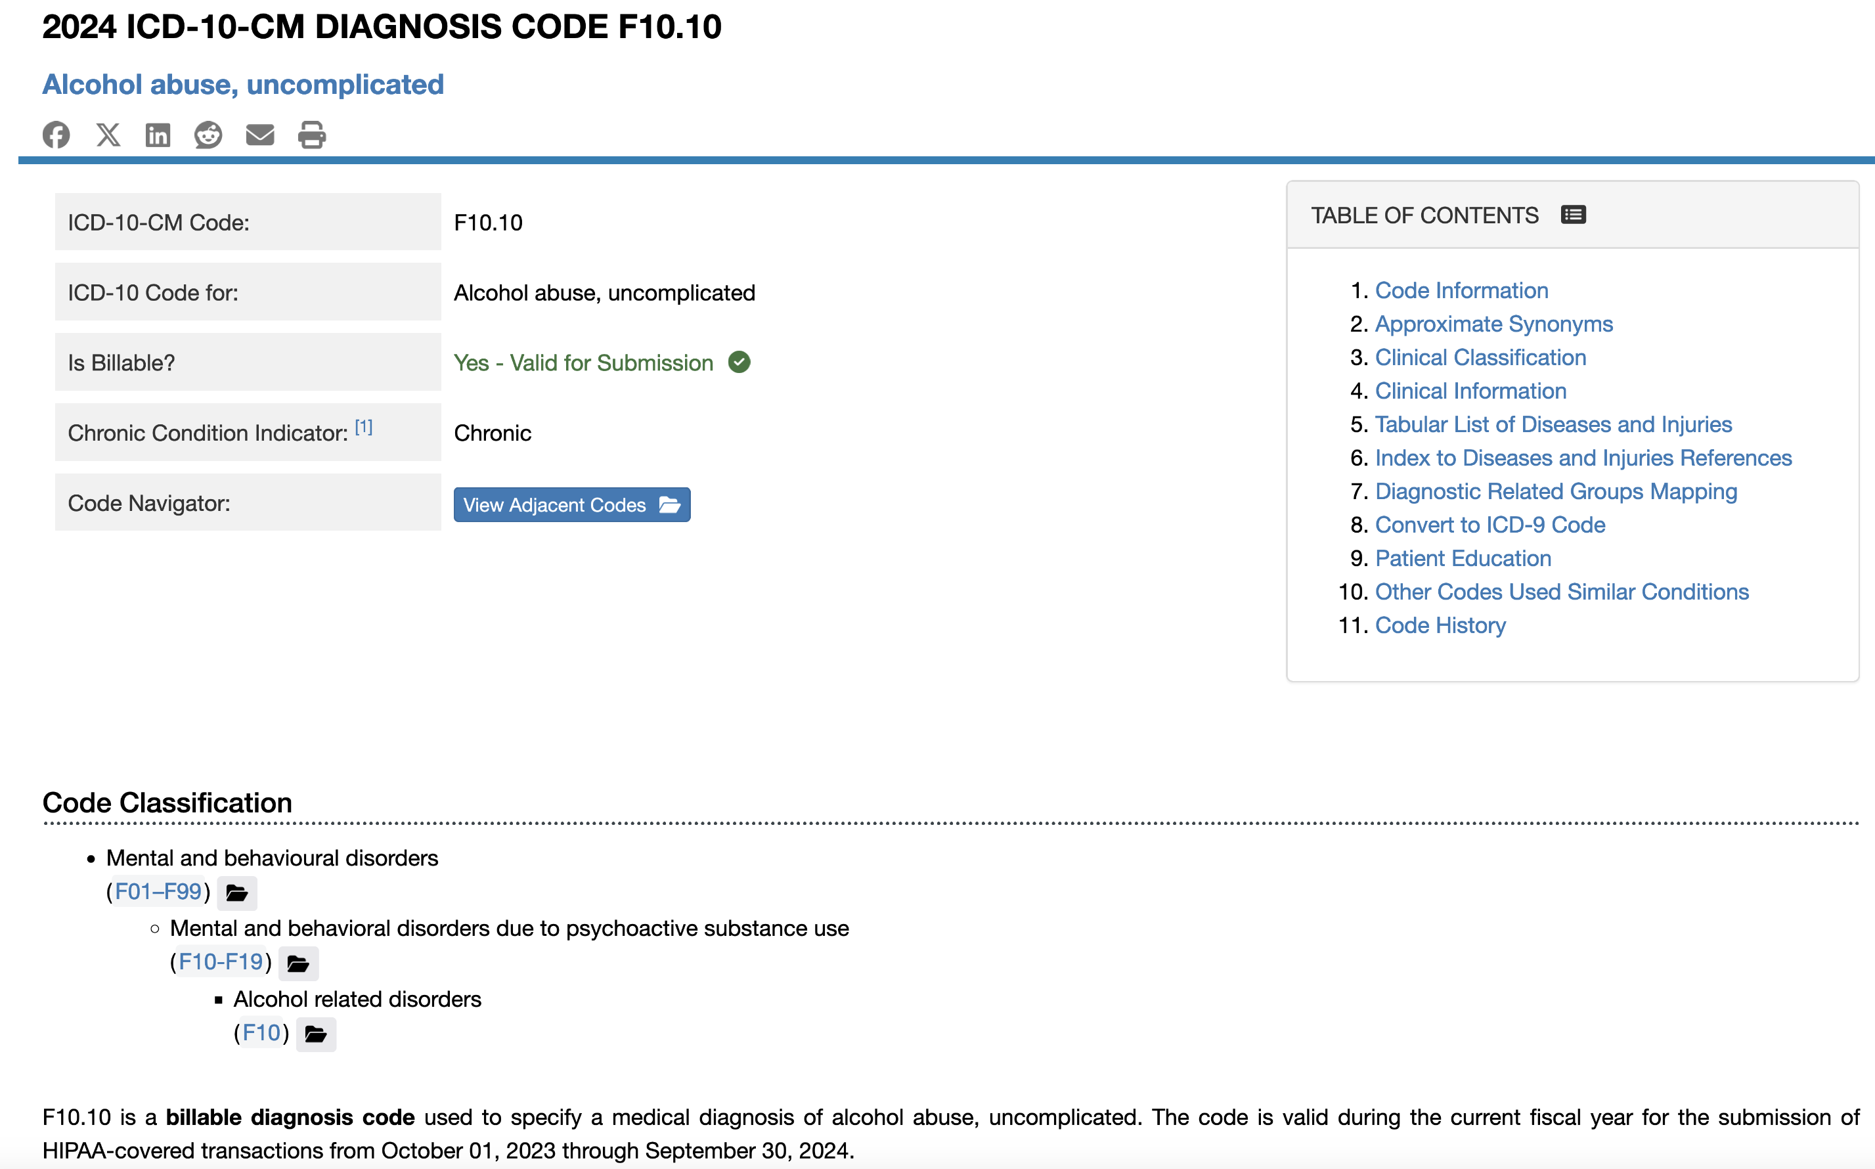
Alcohol and Substance Use Disorder Phenotyping: ICD Codes
International Statistical Classification of Diseases and Related Health Problems (ICD) is a medical classification list that contains diseases, diagnosis, and symptoms.
These codes are used to help identify cases like substance use disorders (SUD) which extends to alcohol use disorders (AUD).
However, ICD codes may not be the most accurate way to detect cases due to complex electronic health record data (E.H.R).

Slide 4
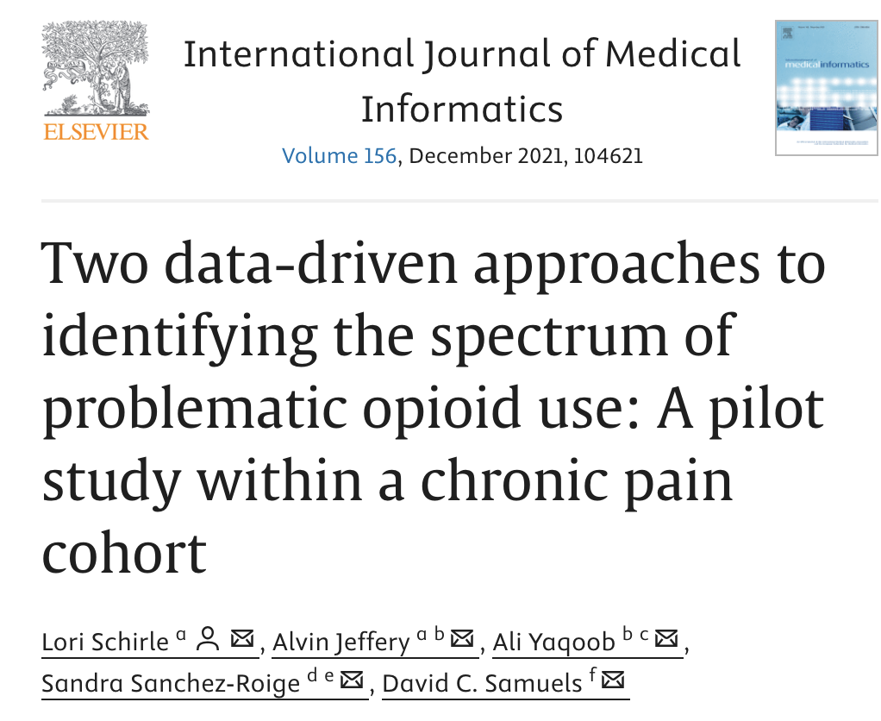
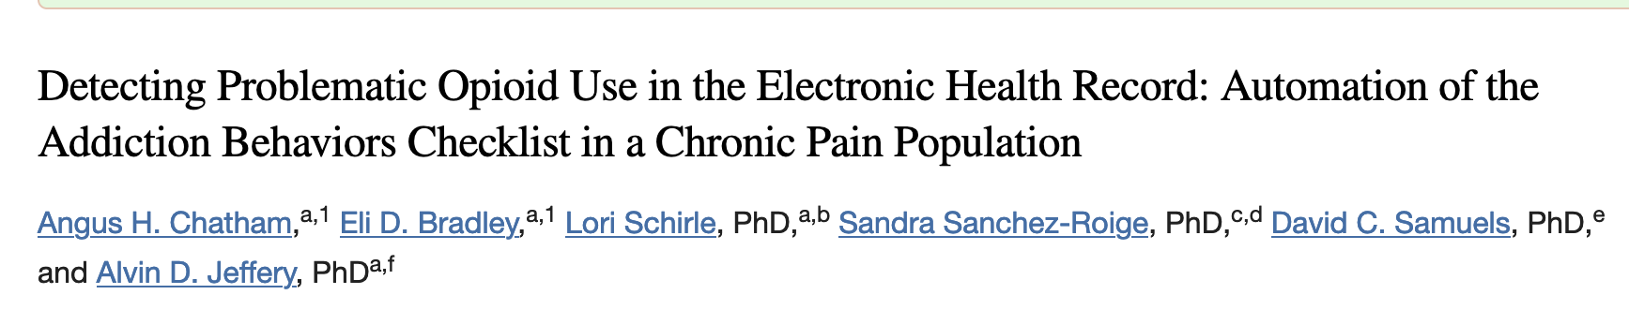
Natural Language Processing (NLP) and AUD Identification
Studies have shown that using natural language processing (NLP) to identify SUD concepts in clinical notes have promising results.
Automation of Addiction Behaviors Checklist for opioid use disorder
Schirle, L., Jeffery, A., Yaqoob, A., Sanchez-Roige, S., & Samuels, D. C. (2021). Two data-driven approaches to identifying the spectrum of problematic opioid use: A pilot study within a chronic pain cohort. International Journal of Medical Informatics, 156, 104621. https://doi.org/10.1016/j.ijmedinf.2021.104621
Chatham, A. H., Bradley, E. D., Schirle, L., Sanchez-Roige, S., Samuels, D. C., & Jeffery, A. D. (2023). Detecting Problematic Opioid Use in the Electronic Health Record: Automation of the Addiction Behaviors Checklist in a Chronic Pain Population. medRxiv : the preprint server for health sciences, 2023.06.08.23290894. https://doi.org/10.1101/2023.06.08.23290894
Notes:
NLP has been used to produce a measure of OUD risk. Evidence shows that when compared to

Slide 5

How can we expand and use this knowledge for AUD?
This project aims to expand the phenotyping of SUD by focusing on AUD within a chronic pain cohort.
Using natural language processing techniques, the primary objective is to use regular expressions (regex) to search clinical notes for key terms aligned with the Alcohol Use Disorders Identification Test (AUDIT).

Slide 6

Why is this important?
Automation and Application:
If automation of AUD phenotyping with regex proves to be accurate and reliable, this method can enhance diagnosis, identification, and prevention within multiple clinical and genetic contexts.

Slide 7
Methods: Chronic Pain Cohort
Total Patients (VUMC Synthetic Derivative) | Sex Demographics | Race Demographics
8,063 | Female - 63% Male – 37% | Asian – 1% Black - 16% White - 80.6% Other - 1.5%
Chronic pain defined by ICD codes (relating to chronic pain) occurring 2 different days in patient E.H.R
3,485,348 clinical notes compiled into 68 note files
Chatham, A. H., Bradley, E. D., Schirle, L., Sanchez-Roige, S., Samuels, D. C., & Jeffery, A. D. (2023). Detecting Problematic Opioid Use in the Electronic Health Record: Automation of the Addiction Behaviors Checklist in a Chronic Pain Population. medRxiv : the preprint server for health sciences, 2023.06.08.23290894. https://doi.org/10.1101/2023.06.08.23290894

Slide 8
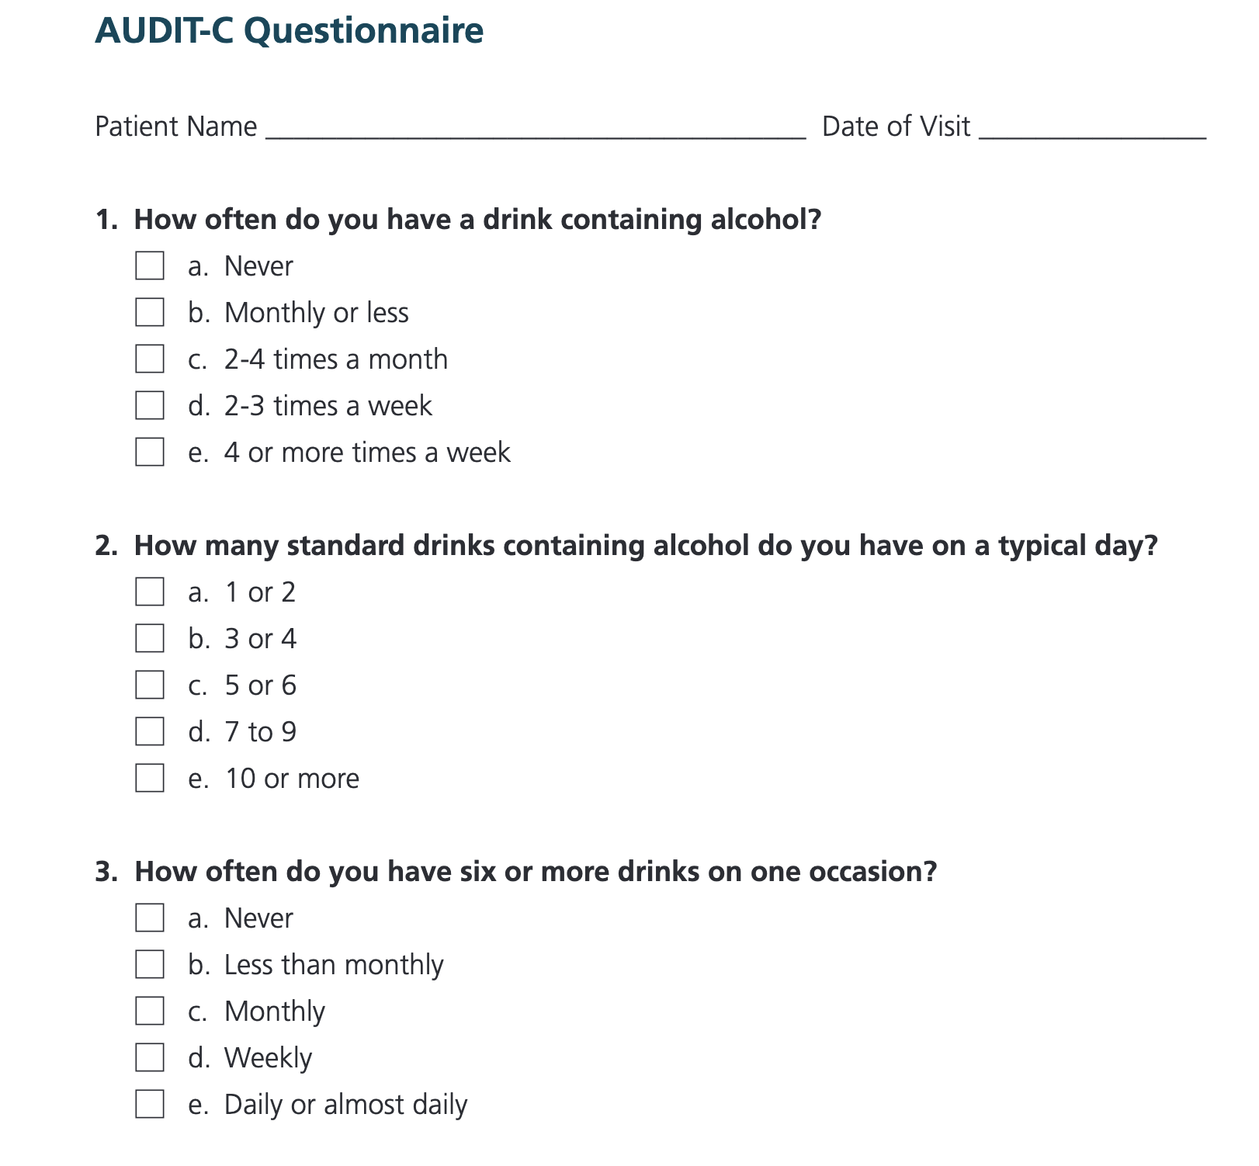
Methods: AUDIT-C
The Alcohol Use Disorders Identification Test (AUDIT) is a screening tool used to assess drinking behaviors and alcohol consumption.
The AUDIT-C is a shortened version of this checklist that includes the first three questions of the AUDIT. Our team previously developed regex patterns for the first three questions.

Slide 9
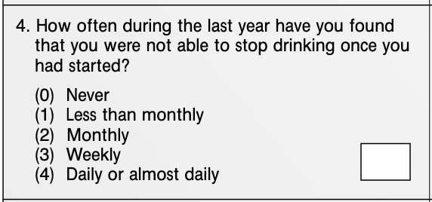
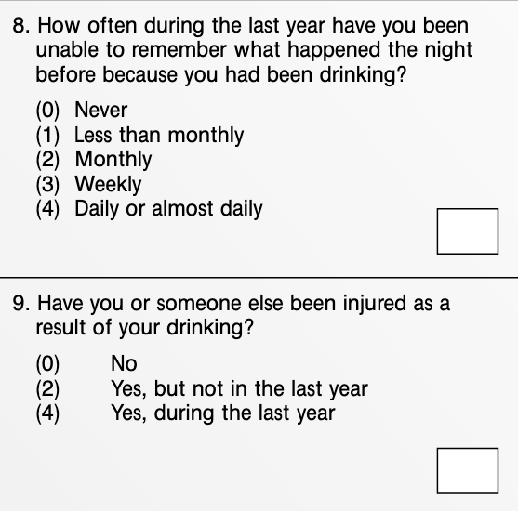
Methods: AUDIT and RegEx
Of the 10 questions, this project focused on developing questions #4, 8, and 9.
These questions were converted into regular expressions (regex) which are tools that can search for patterns and matches to specific key words and phrases within text.
https://nida.nih.gov/sites/default/files/files/AUDIT.pdf

Slide 10
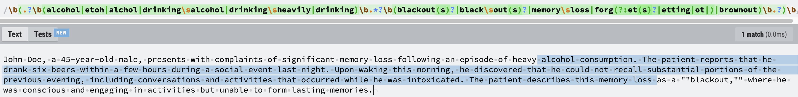
Example for question 8

Slide 11
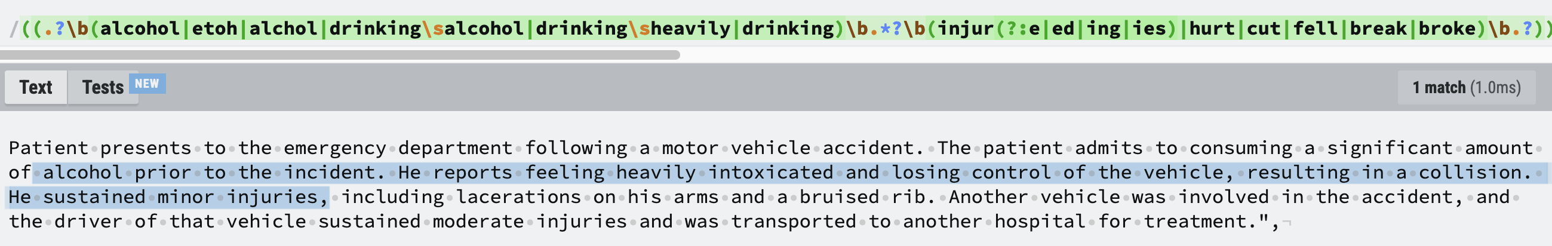
Example for question 9

Slide 12

Results - Chronic Pain Cohort
After testing regex patterns on 15 compiled note files, we found:
2 matches for question 9
1 match for question 8
No matches for question 4

Slide 13

Challenges and Future Directions
Cohort Selection:
The chronic pain cohort for this project was initially created for a study on opioid use disorders.
Future Studies:
Potentially explore using a different cohort, such as one specifically selected for alcohol use disorder or including patients with liver conditions, to enhance generalizability and robustness of findings.

Slide 14
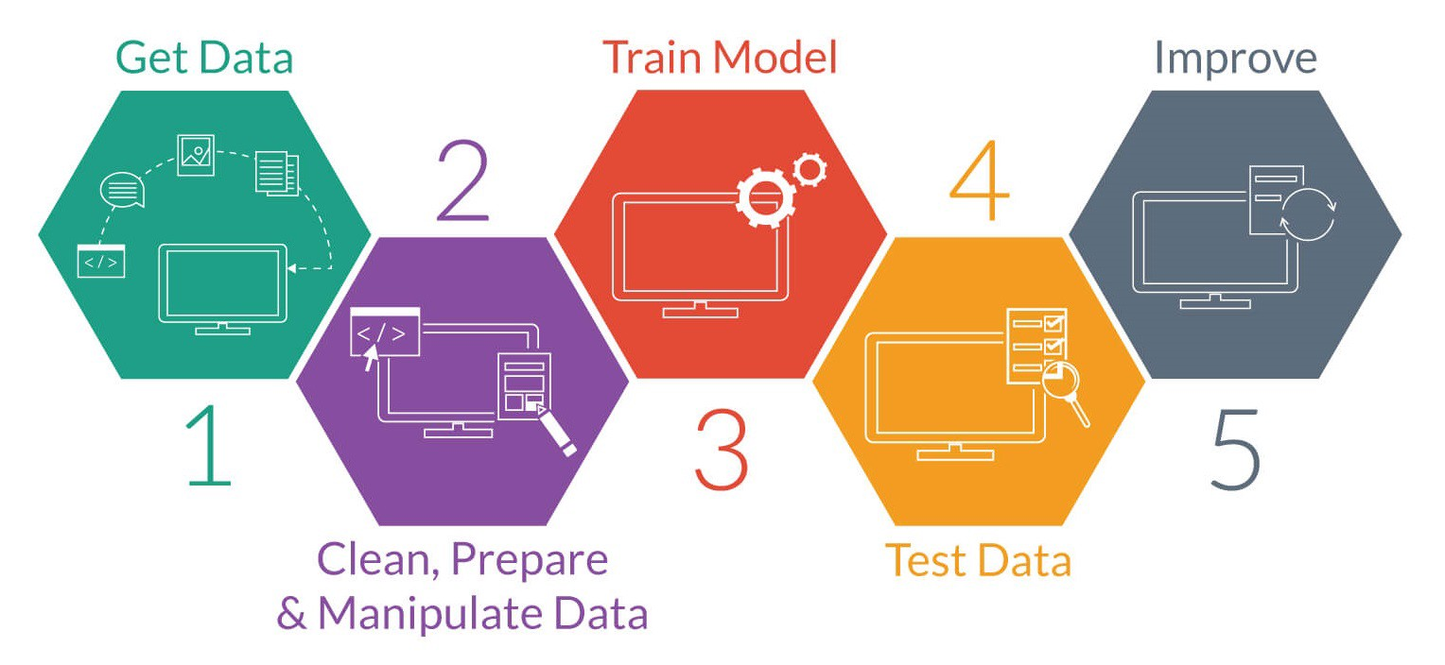
Challenges and Future Directions
Regular Expressions:
Searching for simple phrases or words serves as an easy way to identify patterns within text.
However, searching for more nuanced terms may prove to be a more complex process.
Advanced NLP Techniques:
Incorporate advanced LLMs to capture the nuances of the AUDIT questions more effectively.

Slide 15


Future Steps
New cohort focused on AUD
Further testing and eventual evaluation by experts

Slide 16


Acknowledgements & Funding
I would like to acknowledge Dr. Alvin Jeffery, Dr. Kim Unertl, Dr. Lei Qian, Rischelle Jenkins, and Abigail Doyle.
This work was funded by NIH NLM 5R25LM014216 and Avenir DP1 under Award Number DP1DA056667.

Slide 17

Thank you! Any Questions?
Michaela.robinson@vumc.org
Mprobinson07@my.fisk.edu

Slide 18
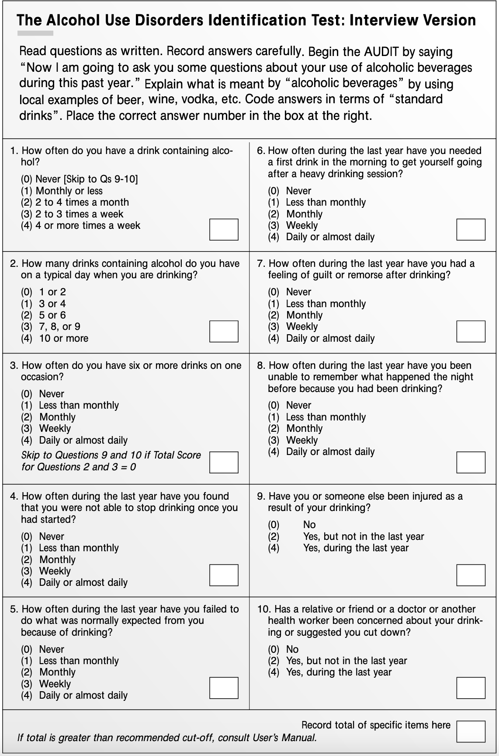
AUDIT Checklist
https://nida.nih.gov/sites/default/files/files/AUDIT.pdf

